Slide 1


PROJECT REVIEW ON
Segregation of News Articles Based on the
Political Bias
BY GROUP-2
Shubham Chaudhari
Arpita Dhote
Mrunali Gorde
Durvesh Palkar
GUIDE
Prof. P. A. Patil

Slide 2
PROBLEM STATEMENT
People's failure to build an internal buffer against their own prejudice has caused the spread of fake facts to plague our society, which is increasingly bringing us to a world where views are just divided. Today's modern algorithms of innovation lock us in our "filter bubbles" by offering us material that corresponds with our innate prejudices regardless of whether such prejudices are really grounded. So with the help of our proposed system people can make informed decisions.

Slide 3
ABSTRACT
Nowadays, because of news biased coverage, news readers can encounter an “echo chamber”, which leads to individuals forming opinions with only one side of the story in mind. Therefore, in order to give more choice to the end user to make an informed decision,we decided to implement our suggested method reminding the public first of all how unfair the news article is by measuring and showing a bias score to benchmark the latest article with others. After this, it offers news articles from both liberal and conservative perspectives.

Slide 4
INTRODUCTION
News articles are the prime source to gain the information about an event & thus play a crucial role in shaping individual and public opinion. However, media coverage often exhibits an indoor bias, reflected in news articles & commonly observed as media bias or slanted news.
The factors which can be responsible for media bias are ownership or journalists or source of income of the media outlet, or a particular political point of view of the outlet and its audience. The single distributor of news can control what is shown to the news reader.
Therefore, in order to supply more choice to news reader to create an informed decision. We have come up with a system which informs the reader how much the article is biased by calculating and displaying a bias score to benchmark that particular article with others. It also offers news articles from both liberal and conservative perspectives.

Slide 5
LITERATURE SURVEY
Sr. No | Name of the Paper | Methodology | Limitation
1 | A Bias Aware News Recommendation System | The recent Pew research report is used to collect news sources that readers with varying political inclinations prefer to read. Then scrape news articles on a variety of topics from these varied news sources. After this,it perform clustering to find similar topics of the articles,& calculate a bias score for each article. | The system uses the pew report which could not be useful while browsing as well as not politically aware enough to judge how biased the articles were.
2 | Automated Identification of Media Bias by Word Choice and Labeling in News Articles | Firstly,it present NewsWCL50, the first open evaluation dataset for the identification of bias by WCL consisting of 8,656 manual annotations in 50 news articles.Then it extract instances of bias by WCL while outperforming state-of-the-art methods,such as coreference resolution, after which it evaluate on the NewsWCL50 dataset, achieving an F1=45.7% compared to F1=29.8% achieved by the best performing state-of-the-art technique.Lastly,a | The estimation of abstract or implicitly described frame properties is beyond the capabilities of current NLP as

Slide 6
Sr. No | Name of paper | Methodology | Limitation
 |  | prototype which demonstrate the effectiveness of approach in finding frames caused by bias by WCL. | well as there is need to improve the estimation performance
3 | Introduction to Multitask Ordinal Regression for Jointly Predicting the Trustworthiness and the Leading Political Ideology of News Media | A multi-task ordinal regression framework is used for jointly predicting trustworthiness & political ideology of news media sources, using several auxiliary tasks,then it fact-check the news before they were even written: by checking how trustworthy the outlets that published them are. | There are limited auxiliary tasks to perform and restricted to just one language.
4 | Arkajyoti Misra & Sanjib Basak Political Bias Analysis | LSTM is used to predict the implicit political bias present in a text even if there are no specific words present in the text that obviously relates to one of the two major political ideologies.. | It lack in accuracy & unable to perform well on data set.

Slide 7
Sr. No | Name of paper | Methodology | Limitation
5 | Mohit Iyyer, Peter Enns, Jordan Boyd-Graber, Philip Resnik. Political Ideology Detection Using Recurrent Neural Networks | A recursive neural network (RNN) to detect ideological bias on the sentence level & develop a new political ideology dataset annotated at the phrase level. | There were too many parameters for this model to work well here, other variations might prove successful, especially with more data.
6 | Detecting Political Bias in News Articles Using Headline Attention | lt builds a vector for news article by aggregating important words obtained by paying attention based on headline representation. | There is a small difference in accuracy of predicted bias when comparing the headlines to considering the whole article.
7 | Political News Bias Detection using Machine Learning Minh Vu | Multilayer Perceptron(MLP) model is implemented in a Google Chrome extension, which can perform an extensive scan whenever users navigate to a news article. The extension then determines the ideological components of the article, in percentages of conservative, liberal or neutral sentences. | MLP classifier did not take into consideration relations between different words and phrases, which led to inaccurate classification results of online news.

Slide 8
Sr. No | Name of paper | Methodology | Limitation
8 | Multi-view Models for Political Ideology Detection of News Articles | Multi-view mode used to leverage cues from all of the views to identify the ideology revealed by a news article. Its model draws on advances in representation learning in natural language processing and network science to capture cues from both textual content and the network structure of news articles & the empirically evaluate its model against a battery of baselines and show that its model outperforms state of the art by 10 percentage points F1 score. | Do not have proper segregation of the biased news
9 | Towards Bias Inducing Word Detection by Linguistic Cue Analysis in News Articles | It detect the bias words effectively by employing the concept of inverse document frequency (IDF), which is a well-known statistic in the information retrieval, as one of the features to represent the word in the news article& it also present a news bias detecting method in a hierarchical manner | Don’t have labeled dataset to evaluate how well the bias detecting process based on relative features captures bias in the newspaper by utilizing human resources

Slide 9
Sr. No | Name of paper | Methodology | Limitation
10 | Search bias quantification : investing political bias in social media & web search | Novel generalizable search bias quantification framework measure the sources of bias in political searches on Twitter social media search where both input data & ranking system contribute to the final output bias seen by the user & also compare the relative bias for political queries on Twitter social media search & Google web search. | The main obstacle for expanding this set of queries included finding a set of queries that are not biased towards any party or candidate & Twitter data collection limitations.
11 | Classifying the Political Leaning of News Articles and Users from User Votes | Three semi-supervised learning methods that propagate classifications of political news articles and users as conservative or liberal, based on the assumption that liberal users will vote for liberal articles more often, and similarly for conservative users and articles. | Lost accuracy with the addition of datasets such as friendship links & HTML links where the correlation was lower & require interactions between stories and users
12 | Predicting News Bias | Created a dataset, with the use of Twitter as a topic indexer, from ten agencies around five topics, include ten articles for each for a total of five hundred news stories & then train the algorithm with the use of only eight agencies after which the two agencies left out in the training phase for validation. | The algorithms used have not been thoroughly examined and questioned, due to which it need improvements.

Slide 10
Sr. No | Name of paper | Methodology | Limitation
13 | Mining Sentiment Classification from Political Web Logs | Investigate the utility of Naïve Bayes and SVMs on a novel collection of datasets created from web log posts.Naïve Bayes classifier significantly outperforms Support Vector Machines at a confident level of 99%, with a confidence interval of [1.425, 3.488]. Naive Bayes classifier is sensitive to the class makeup of the dataset. Not having a balanced composition of the classes introduces a bias within the results; the majority class is more likely to be classified correctly than the minority class. As the databases decrease in size, the bias effect due to the unbalanced composition of the datasets magnifies. | It does not have the ability to track changes within people’s opinions on a particular topic and can not explore the time dependency of its data..
14 | Exploring media bias with semantic analysis tools: validation of the Contrast Analysis of Semantic Similarity (CASS) | CASS used to investigate semantic structure when exploring any topic that affords a large text-based database. Three types of analyses: (a) estimating group differences between channels, (b) examining individual differences in bias between newscasters, and (c) exploring the value of CASS approach in comparison to another popular measure of media bias | The limitation of this approach is that measurement of media bias is its dependence on lexical information which result in underestimating the result.

Slide 11
Sr. No | Name of paper | Methodology | Limitation
15 | Content Based Fake News Detection Using Knowledge Graphs | B-TransE Model(Binary-TransE model) is used to detect fake news based on news content using knowledge graphs. Along with B-TransE Model , Single-TransE model is also used as a supportive one. | No explanations given to the results of fake news detection even with incomplete and imprecise knowledge graphs.
16 | Fact Checking in Heterogeneous Information Networks | They used both entity type and predicate type information to test the validity of the proposed statement. We use logistic regression to train the model | The limitation of this approach is it does not use association rule mining and topology-based approaches independently.
17 | Prediction of Average and Perceived Polarity in Online Journalism | They applied supervised machine learning algorithms including L2-regularized L2- loss SVM, Naive Bayes, and Linear Regression to predict the mean polarity for each article and the perceived polarity of that article by any given reader. | The dataset is small and can be improved. The results are not too accurate and need to train the RNN models.

Slide 12
Sr. No | Name of paper | Methodology | Limitation
18 | Linguistic Models for Analyzing and Detecting Biased Language | In linguistic analysis, automatically detect and correct instances of bias, by first finding biased phrases, then identifying the word that introduces the bias, and finally rewording to eliminate the bias. | There is acceptable errors in which words wrongly predicted as bias-inducing may well introduce bias in a different context.
19 | Deep Reinforcement Learning for Mention-Ranking Coreference Models | It has apply reinforcement learning which is REINFORCE policy gradient algorithm and a max-margin objective,to directly optimize a neural mention-ranking model for coreference evaluation metrics.It has optimize models for coreference evaluation metrics by removing the need for hyperparameters that must be carefully selected for each particular language, dataset, and evaluation metric. | It cannot resolve Word and Choice Labelling candidates
20 | Comparisons of Sequence Labeling Algorithms and Extensions | It has survey the current state-of-art models for structured learning problems & came up with a new method which is Structured Learning Ensemble (SLE) to combine the structured learning models & provides more accurate solutions compared with the best results of the individual models. | Require large amounts of training data, which do not exist currently.

Slide 13
Sr. No | Name of paper | Methodology | Limitation
21 | Coupling Niche Browsers and Affect Analysis for an Opinion Mining Application | It has couples both Niche Browsers and Affect Analysis in order to provide an entity-directed opinion miner which test its miner on text from sites which know to be favorable or unfavorable to certain entities, by examining its results over left and right-wing political figures in conservative and liberal newspaper. | Need improvement in the method because of poor performance in the sensitivity of the method.
22 | News Topic Classification using Mutual Information and Bayesian Network | Mutual Information (MI) is used as text feature selection method which is applied to reduce the high dimension of data,to provide relevant features for Bayesian Network so it could have a good performance in classifying news articles. | Mutual Information does not reduced the computational time & need improvement in performance.
23 | A survey of named entity recognition and classification | Here it extract and classify mentions of rigid designators, from text, such as proper names, biological species, and temporal expressions. | It cannot resolve Word and Choice Labelling candidates

Slide 14
Sr. No | Name of paper | Methodology | Limitation
24 | Deep Reinforcement Learning for Mention-Ranking Coreference Models | It has apply reinforcement learning which is REINFORCE policy gradient algorithm and a max-margin objective,to directly optimize a neural mention-ranking model for coreference evaluation metrics.It has optimize models for coreference evaluation metrics by removing the need for hyperparameters that must be carefully selected for each particular language, dataset, and evaluation metric. | It cannot resolve Word and Choice Labelling candidates
25 | Analyzing Political Bias through a User Friendly Interface | Backpropagation Algorithm is use to train the neural networks. Preprocessing is used to train and test the data based on sequencing. | The data set used is quite small which puts restrictions to the learning of model, there is need of large datasets.

Slide 15
PROPOSED SYSTEM
Recently, the analysis & automated identification of media bias in news articles have gained the attention in the field of computer science. The established systems currently provide no support for showing the assorted perspectives contained in articles reporting on the identical occurrence. Therefore, the purpose of our proposed system is to inform the reader how much the article is biased by calculating and displaying a bias score to benchmark that particular article with others & offers news articles from both liberal and conservative perspectives.

Slide 16
METHODOLOGY
The first move in our program is to scrape news articles from a combination of outlets of conservative and liberal audiences, as well as mainstream and non-mainstream media sites. After that we are computing a bias score for the news articles & going to display bias score for each articles. After which we will recommend an option to see news articles from both liberal and conservative perspectives.

Slide 17
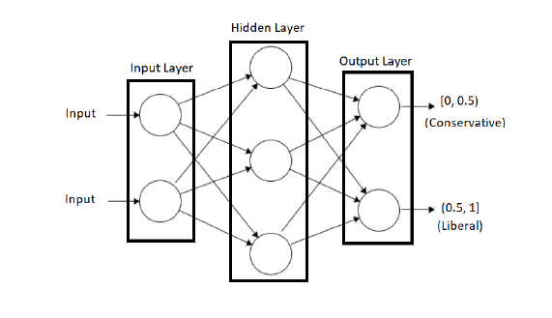
HOW RNN DETERMINES BIAS

Slide 18
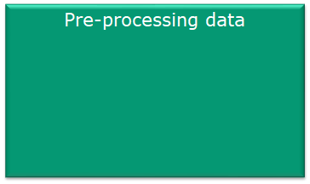

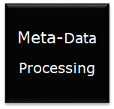











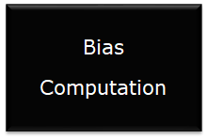
SYSTEM DESIGN

Slide 19
MODULE SPLIT-UP
NEWS CRAWLER
BIAS SCORE PREDICTION
URL RECOMMENDATION

Slide 20
SOFTWARE TOOLS
Software tools Used:-
Windows
Jupyter Notebook
Software Technologies Used:-
Flask
Beautiful Soup
Keras
Selenium

Slide 21
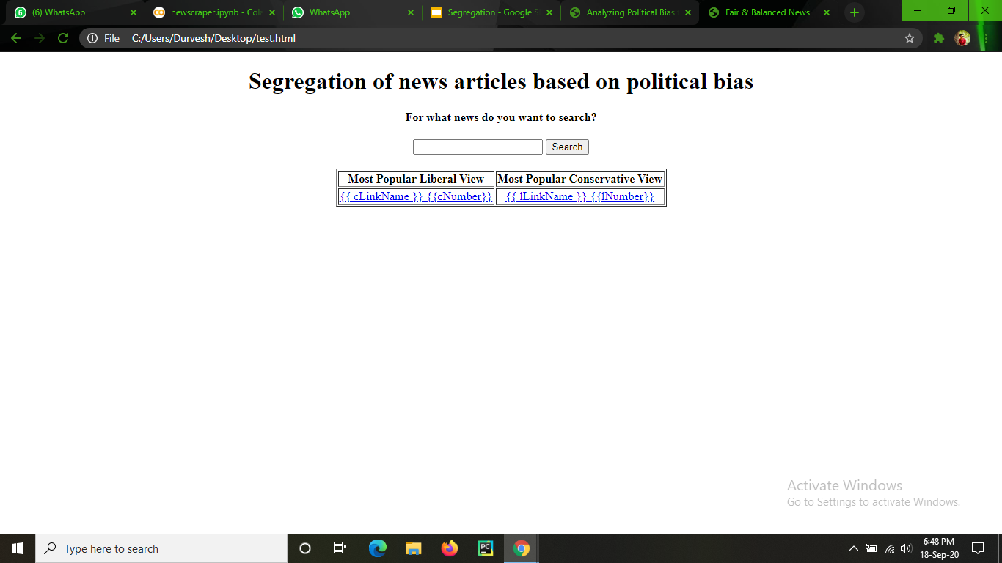
WORKING MODULE

Slide 22
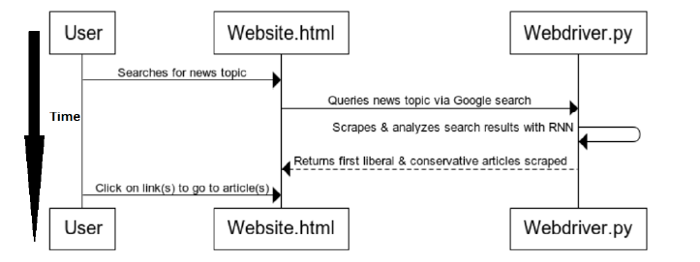

Slide 23
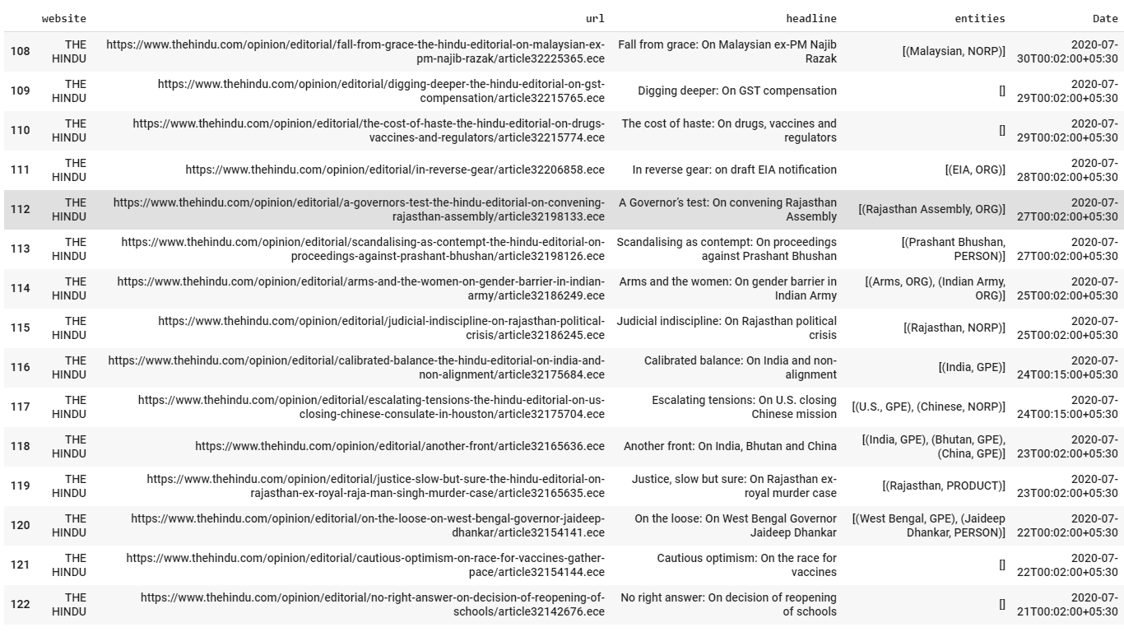
CODE IMPLEMENTATION
IMPLEMENTED WEB CRAWLER USING PYTHON TO COLLECT NEWS ARTICLES FROM VARIOUS WEBSITES

